Slide 1
Ground Penetrating Radar
Control Unit
Team 24
Tyler Castro
Coy Coburn
Daniel Miller
Michael Turner
Transmitter Circuit
Receiver Circuit
Objective: To map underground root systems
The transmitter will pulse a signal to penetrate the ground.
The receiver will take the reflected signal.
The control unit will display the created radar image and record an image log.
The main feature of this GPR system is the phased array antennas.
Transmitter Antenna
Direct Signal
Receiver Antenna
Transmitted Pulse
Reflected Pulse
Buried Object

Slide 2
Subsystem | Primarily Responsible Team Member | Student Responsibilities/ Tasks
Transmitter Circuit | Tyler | Design and implement the circuit to transmit the RF signal as well as utilize pulse compression via chirping the signal.
Transmitter Antenna | Daniel | Design phased array antenna for generating signal
Receiver Antenna | Coy | Successfully catch reflected signals and mix said signals for A/D conversion.
Receiver Circuit | Michael | Design the receiver components and verify that they adjust the signal properly before mixing.
Control Unit | Coy | Allow for user manipulation of the GPR device and image processing for the radar display.

Slide 3
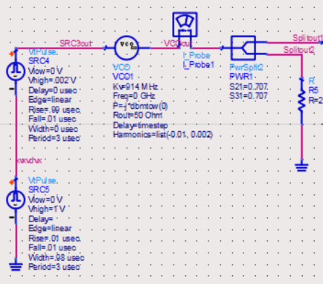
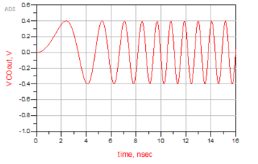
Tyler Castro
A modulator generating a sawtooth signal is connected to a voltage controlled oscillator
Resulting signal is a linearly modulated chirp, with frequency from 902 to 930 MHz
A chirp allows for better filtering on the receiving end

Slide 4
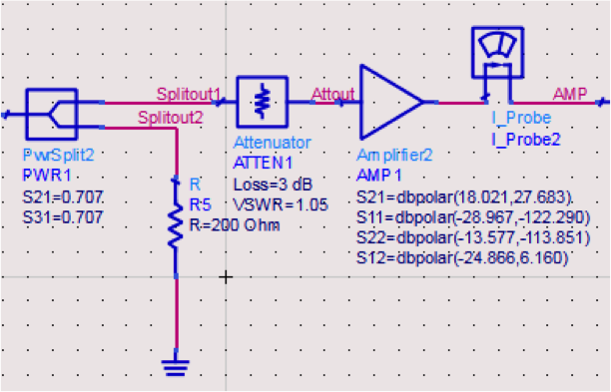
Daniel Miller
Splitter for sending to a mixer on the receiving end
Attenuator for impedance matching
Amplifier S-parameters based off of an PA of 11 dB gain, ZX60-3011+

Slide 5
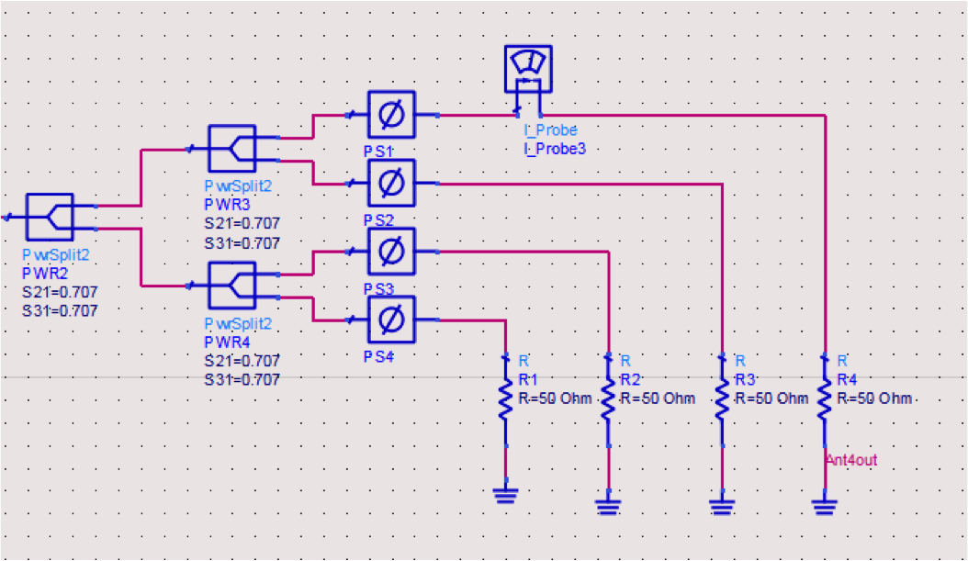
Daniel Miller
50 ohm resistors used to represent antenna load
Phase shifters used to direct or focus antenna pattern

Slide 6
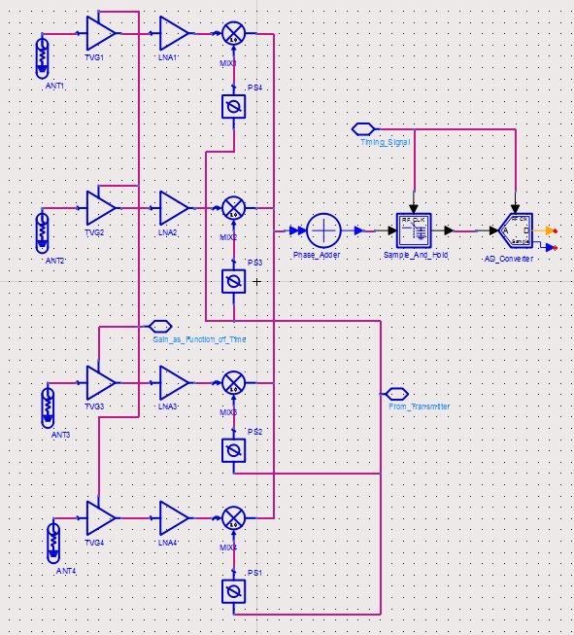
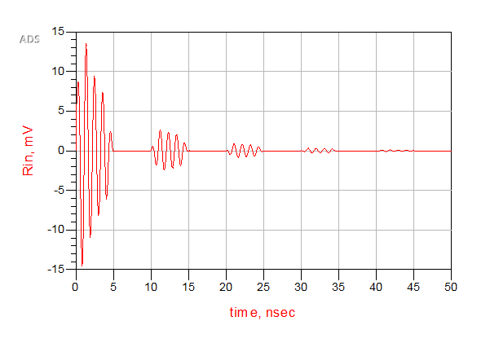
Coy Coburn
The phased array on the receiver side utilizes the homodyne design
Initial simulations involve a decaying sine wave with pulses to represent reflected signals from objects
Incoming reflections will be mixed with the original generated signal for matched filtering

Slide 7
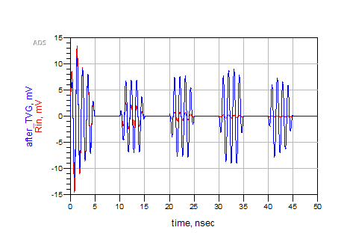
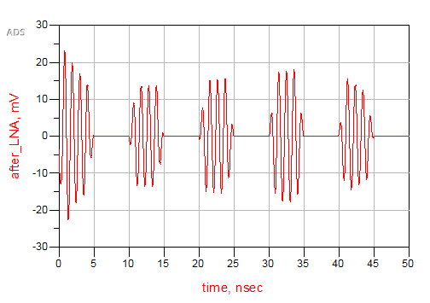
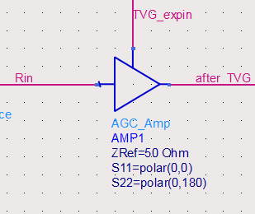
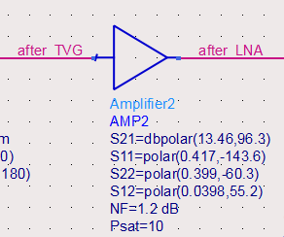
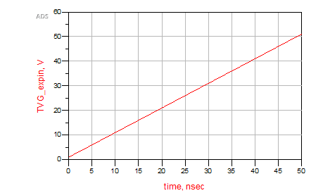
Michael Turner

Slide 8
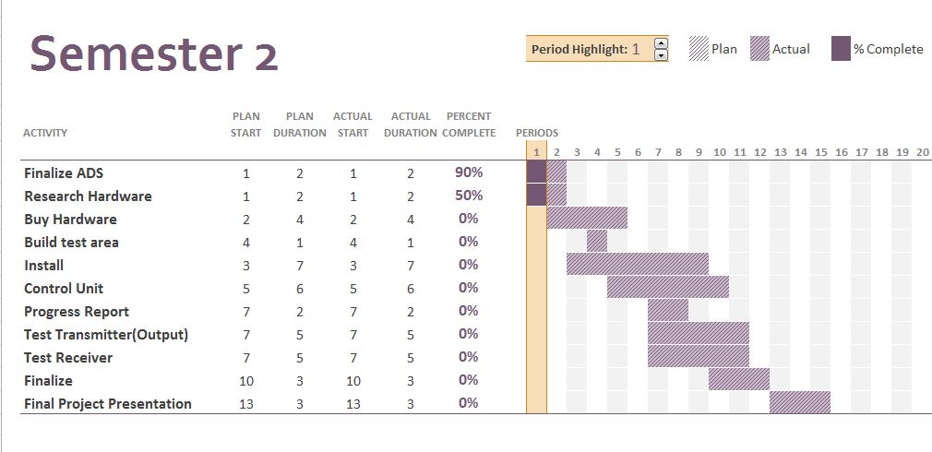
Gantt Chart

Slide 9
Summary/Conclusion
In summary, both the transmitter and receiver subsystems are the main focus for the team as a whole at the moment. Once simulations have been finalized, hardware will be bought and installed which will occupy most of the semester. The control unit subsystem will then be the main priority along with field testing of the GPR. While there is much work that still needs to be done, progress so far is encouraging.

